Slide 1
Blockchain in capital market
Submitted By: -
Yugesh Dhiman
Sahil Sharma
Neharika Mittal
Shivam Banyal
Janvi
Mrityunjay

Slide 2
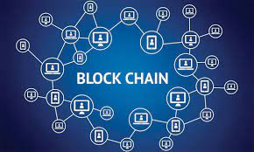
INTRODUCTION to blockchain
Blockchain is a decentralized digital ledger that records transactions on multiple computers in a secure and transparent manner. It was first introduced in 2008 as the underlying technology for Bitcoin, but its potential applications extend far beyond cryptocurrencies.

Slide 3
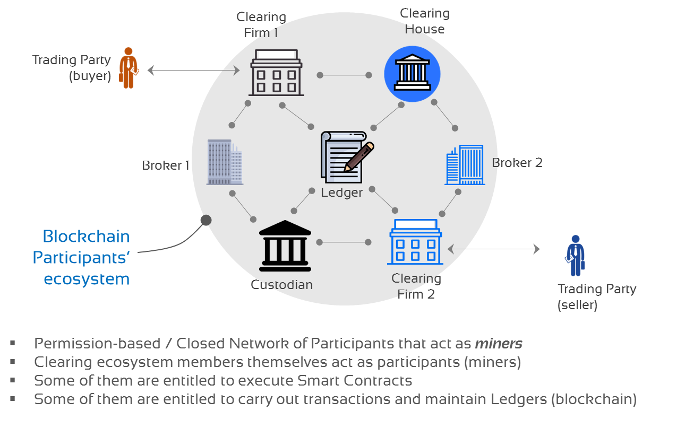
Blockchain in capital market
In capital markets, blockchain can be used to streamline settlement and clearing processes, reduce counterparty risk and increase transparency. It has the potential to revolutionize the way financial institutions operate, making them more efficient and cost-effective.

Slide 4
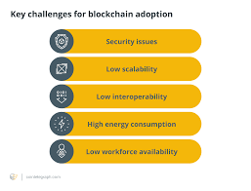
Challenges of blockchain in capital markets
Regulatory uncertainty
Interoperability
Scalability
Security
Integration with legacy systems

Slide 5
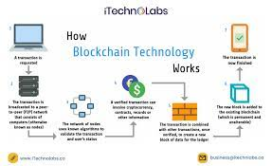
Real-World Applications of Blockchain in Capital Markets
Trading and settlement
Securities issuance and trading
Clearing and settlement
Asset management
Regulatory compliance

Slide 6
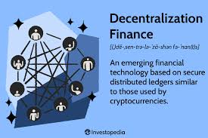
Future of Blockchain in Capital Markets
Increased adoption
Digital securities
Interoperability
Decentralized finance (DeFi)
Central bank digital currencies (CBDCs)

Slide 7
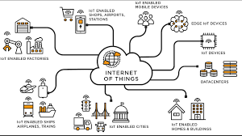
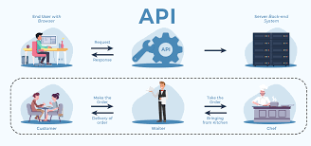
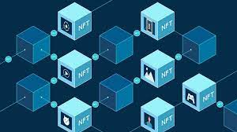

Use of technologies in capital market
IOT
API
BLOCKCHAIN
CLOUD

Slide 8
Use of technologies in capital market
Trading platforms
Market data and analytics
Clearing and settlement
Risk management
Compliance and regulation

Slide 9
FINFLEX
Site: - Finflex.in
It is a trading platform in capital market.
Services offered: -
Trading
Buy and sell
Robo-advisor

Slide 10
Issues in market
Lengthy settlement cycles
High transaction costs
Inefficiencies in processes like reconciliation

Slide 11
With the advent of Blockchain, capital markets firms already have the next level of disruption within their sights and many of the traditional challenges could well be addressed by the technology behind bitcoin. The basic functions of blockchain are:
Decentralized storage of the transaction/asset data across all participants
Immutability of data stored due to hashing principles
Smart contracts which can execute transactions / actions based on business rules

Slide 12
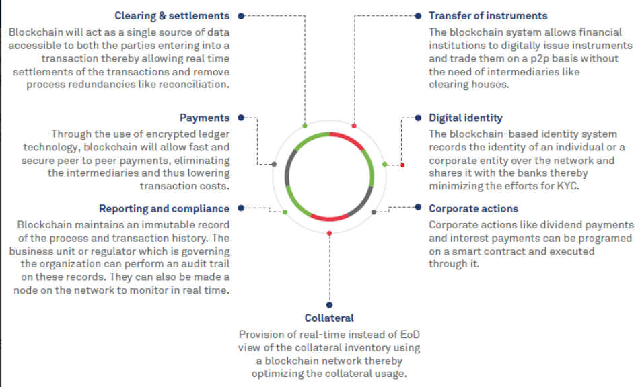
Blockchain in capital market

Slide 13
THANK You

